Slide 1

CS50 SQL Final Project
Project title: Personal finances
Miha Hrovat, 2025

Slide 2
Video requirements
Project title: Personal finances
Name: Miha Hrovat
GitHub and edX usernames: Miketymike (GitHub), mihahrovat (edX)
City and country: Prague, Czech Republic
Date of recording: 03.03.2025

Slide 3
Project background
I like to track my finances, especially when I am dividing costs with my roommate so it is easier to settle shared costs
I also like to have budgets for different categories, so it is easier to analyse where I spend my money

Slide 4
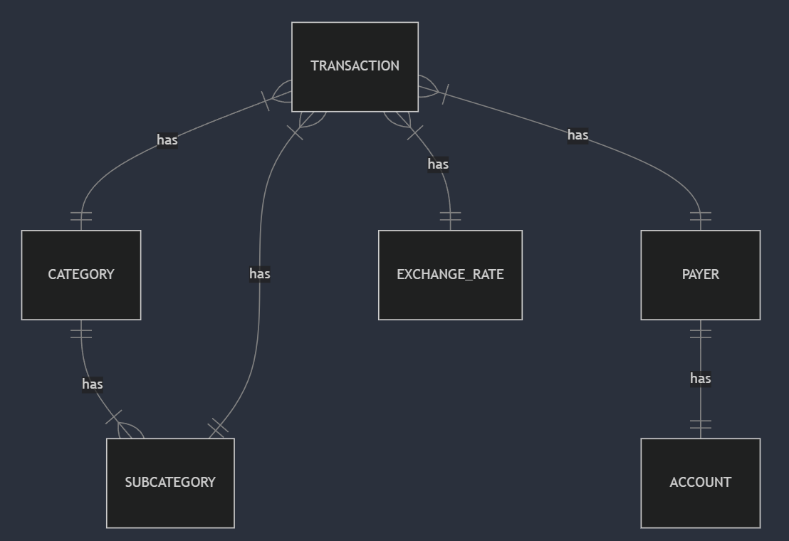

Slide 5
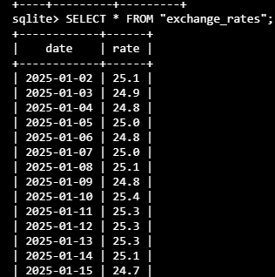
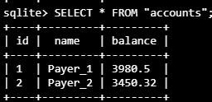
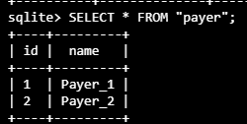
Tables

Slide 6
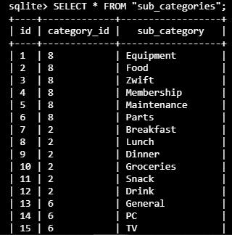
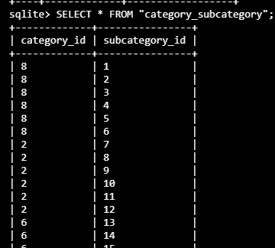
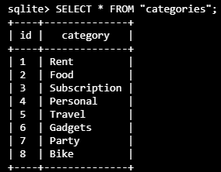
Tables ctd.

Slide 7
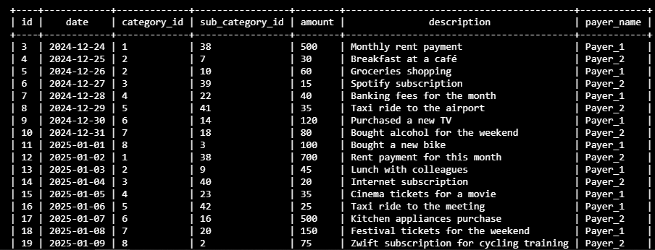

Slide 8
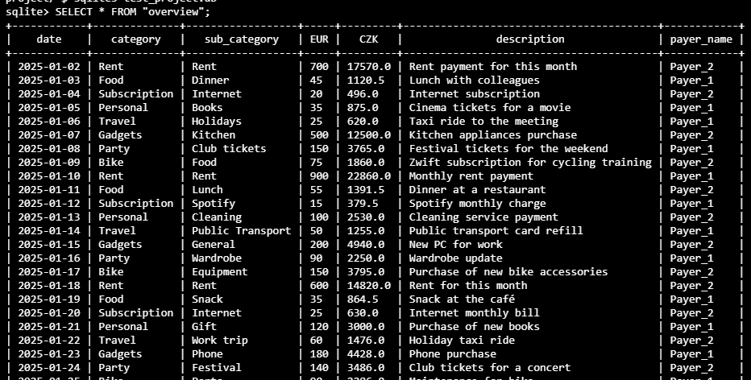
Views

Slide 9
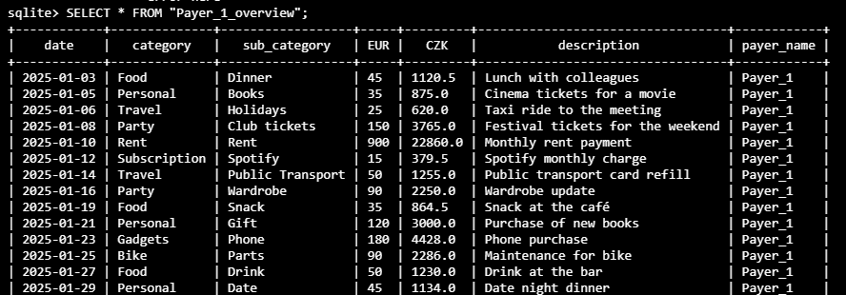

Slide 10
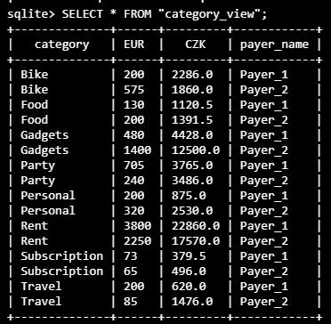
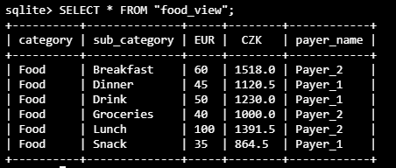

Slide 11
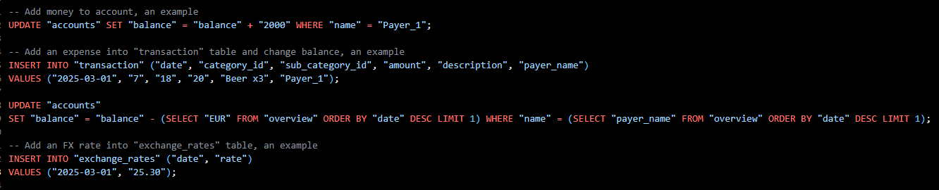
User entries

